Slide 1
Moving from choosing components into design areas Lecture 7

Slide 2
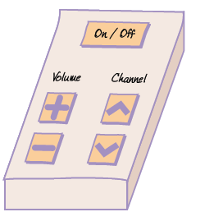
Exercise
Design a remote control for a television that will be used by an elderly technophobe relative. The television does not pick up cable or satellite channels, so only a few channels are available. It should be as simple as possible. Include as few buttons as you can. Assume the current channel number is displayed on the television screen and that the brightness and contrast are already set correctly.
We came up with the sketch shown in Figure.
This allows your relative to switch the television on and off and move between channels.
We have also made it possible to change the volume.
device should be easy to use, as there is a clear and simple mapping between the tasks the user wishes to carry out and the controls.

Slide 3
Principles of Good Layout
To create a usable UI, Both the software components and the interaction devices need to be well laid out
Create Natural Groupings. you need to think about the natural structure of the information. For example, group together all the menus or all the icons that relate to a particular concept such as drawing or formatting.
Separate the Currently Active Components. It is important to emphasize what the user is currently doing.
Emphasize Important Components. It is important to emphasize the components that really matter. That is why panic buttons are red.
Use White Space Effectively. White space refers to areas of the screen that do not contain any other software components.

Slide 4
Principles of Good Layout
To create a usable UI, Both the software components and the interaction devices need to be well laid out
Make the Controls Visible. its function needs to be obvious.
Balance Aesthetics and Usability. The appearance of the UI is becoming increasingly important. This is particularly true in areas such as design and fashion, where UIs are often eye-catching and attractive.

Slide 5
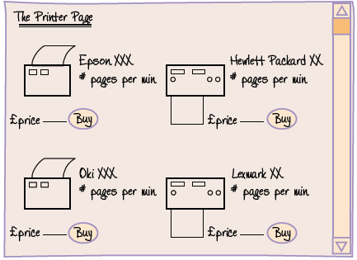
Exercise
Sketch a web page for selling computer printers. This page is aimed at computer enthusiasts browsing on their home PCs. The users are interested in the price and functionality of printers. The screen should show details of several printers, along with prices and photographs.
Explain how you have achieved the following:
Created natural groupings
Emphasized important components
Used white space effectively
Made the controls visible
Balanced aesthetics and usability

Slide 6
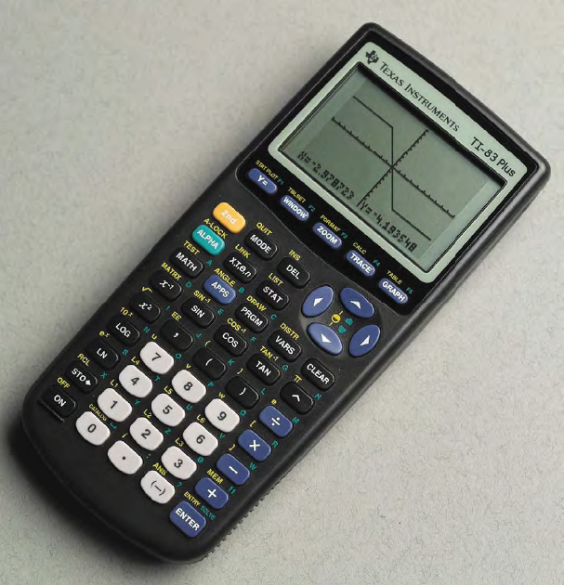
Exercise
Sketch Give a critique of the graphic calculator illustrated in Figure bellow. This calculator is used by students who are studying mathematics at university level. The following features of the calculator cannot be identified from the figure: the screen is not backlit, the screen is not a touch screen, and there is no pen input - there is only keyboard input.

Slide 7
Exercise
Comment on each of the following areas, and suggest how the design could be improved:
Whether the psychological principles for the UI designer have been taken into account.
The choice of input and output devices
The use of text
The use of color
The use of images
Simplicity of design, taking into account the task–action mapping
Whether the principles of layout have been applied

Slide 8
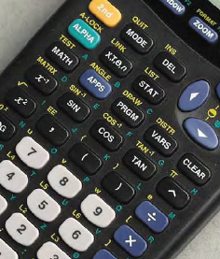
Psychological principles
The layout of the keypad is similar to that of a conventional calculator, so there is a degree of consistency.
when entering a calculation, the screen shows what has been entered and the flashing black cursor indicates where the next number or operator will be displayed.
The structure of the keypad is quite complex. One of the reasons that the calculator appears so difficult to use is that most of the buttons can be used for at least two different functions, and each of these functions is written either on or beside the relevant button. This means that the student can recognize these, rather than recall them, which is good, but the overall effect is overwhelming.

Slide 9
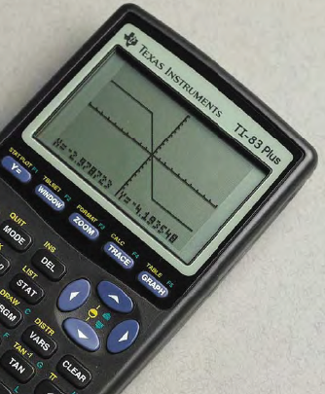
Choice of input device
There is a keypad containing a large number of buttons and an LCD screen. The buttons are reasonably large, allowing the user to press them quite easily.
The device is portable and will usually only be operated by one hand.
The arrow buttons are a different shape which makes it easy to distinguish them and to guess the direction of moving cursor on the screen as each button is pressed.
The keypad is not sealed, so it would not be suitable for a dirty environment, but it should work well in the students study environment.
If a large touchscreen with a pen had been used, it made the device more flexible.

Slide 10
Choice of output device
The screen is an LCD, which is appropriate for a portable device.
The screen is large for a calculator, but not too large. There is a trade-off between screen size and keeping the calculator small.
The resolution is not very good. This could be a problem if detailed readings were needed, but it is sufficient to give the general idea.
The screen is not backlit, so it will be of little use if the lighting is poor or the student has poor eyesight.
A backlit screen might be an improvement.

Slide 11
The use of text
A sans serif typeface has been used for the buttons and a serif typeface on the screen. The latter is a surprising choice, and to our eyes the screen is slightly less readable than the buttons.
However, the type size is large, which helps, and only a limited range of text and numbers is displayed.

Slide 12
The use of color
The screen can only display black on a gray background. This is sufficient for displaying text and graphs.
The background color of the button section is black, the buttons are five different colors, and the text on and around the buttons is in four different colors. Thus, there are a lot of colors. It is difficult to know how the designers could have used fewer colors, given the complexity of the device.
The brightest button is the second button, which is orangey yellow. This is suitable because it is frequently used.
The contrast between the background color and the text colors is generally good.

Slide 13
The use of images
Various types of graphs can be displayed on the screen.
This visualization of data gives this type of calculator a great advantage over other calculators.

Slide 14
Simplicity of design
The screen layout is simple. This is necessary because it is so small.
The layout of the buttons is rather complex. Alternatively, an onscreen menu hierarchy could have been included, with the more advanced commands embedded in the hierarchy.
The mapping for switching the calculator off is not as clear and direct as it might be because it requires two key presses (the second button followed by the On button). This is surprising, as it is such a frequent operation.
A simpler solution would have been to make the On button work as a toggle between on and off.

Slide 15
Principles of layout
Considerable effort has been put into grouping the buttons by color.
They are also grouped by position.
The buttons used for manipulating the graphs are physically separate from the other buttons.
Color is also used to emphasize the important buttons.
there is very little white space. The space around the arrow buttons and beneath the top row of buttons is used effectively.
Most of the buttons are well labeled, the label indicating the purpose of the button.

Slide 16
Principles of layout
Considerable effort has been put into grouping the buttons by color.
They are also grouped by position.
The buttons used for manipulating the graphs are physically separate from the other buttons.
Color is also used to emphasize the important buttons.
there is very little white space. The space around the arrow buttons and beneath the top row of buttons is used effectively.
Most of the buttons are well labeled, the label indicating the purpose of the button.

Slide 17
Design Area
Question: How is a web site like a mobile telephone?
Answer: In some ways they are quite different, but there are similarities: they both use color and text, they are both laid out for ease of use (or should be), and they both respond when you select a button.
A design area:
Graphical user interfaces (GUIs).
Web pages.
Embedded systems, such as handheld devices.
For example, web pages often include GUI widgets, and handheld devices can be used to access the Web. This merging of different design areas is known as technological convergence.

Slide 18
Design Components and Design Areas
When you design a UI, you need to perform the following tasks:
1. Identify the relevant design area, and think about the specific principles, guidelines, and issues for that design area.
2. Consider the conceptual design that you created in response to your requirements-gathering activities.
3. Combine the design components taking into account the demands of the design area and what you want to happen in the UI to meet the requirements.
In the next chapter, we will look at how Tokairo designed the driver’s system. This will be followed by three chapters that look at specific design areas in more detail.

Slide 19
THANKS

